Slide 1
Architecture Development Methodology
Global Engineering
Dawit Lessanu
March, 2018

Slide 2
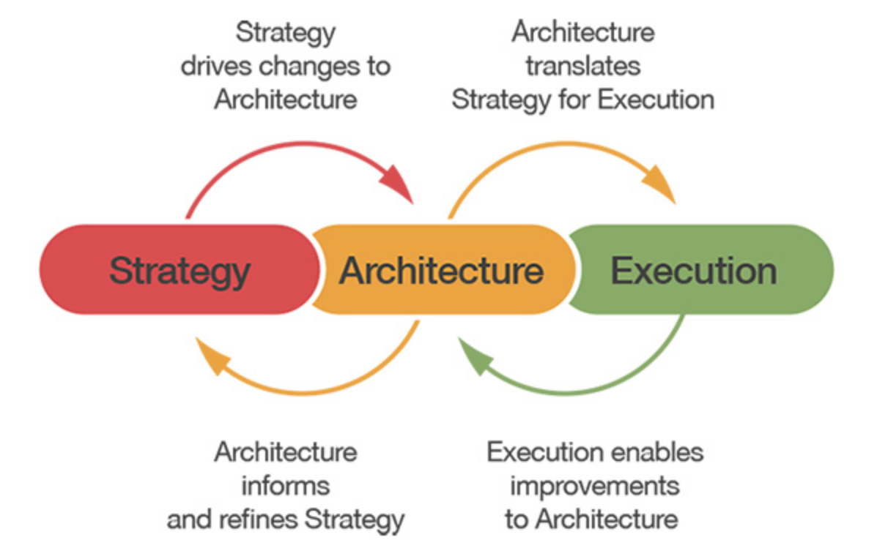
Where does architecture fit in at HS?

Slide 3
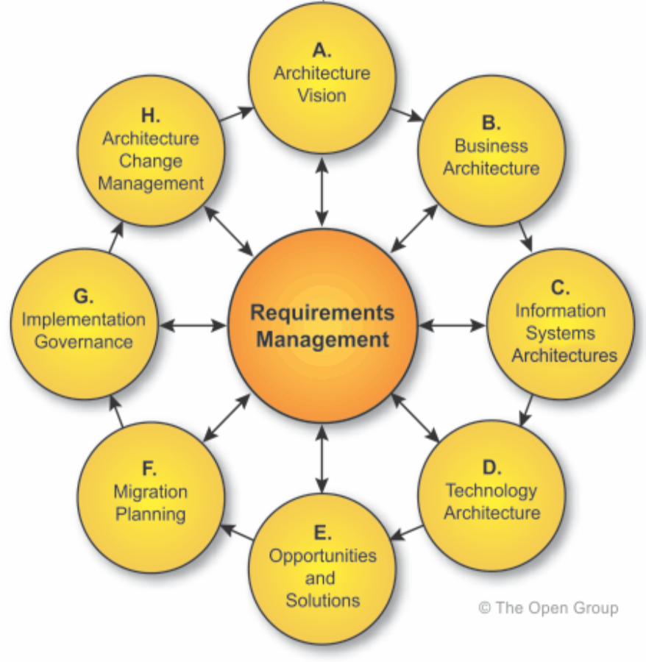
TOGAF - Architecture Development Methodology (ADM)
The ADM is designed to align and communicate information that informs organizational decisions on strategic execution.
The ADM is highly iterative and each phase informs the next.

Slide 4
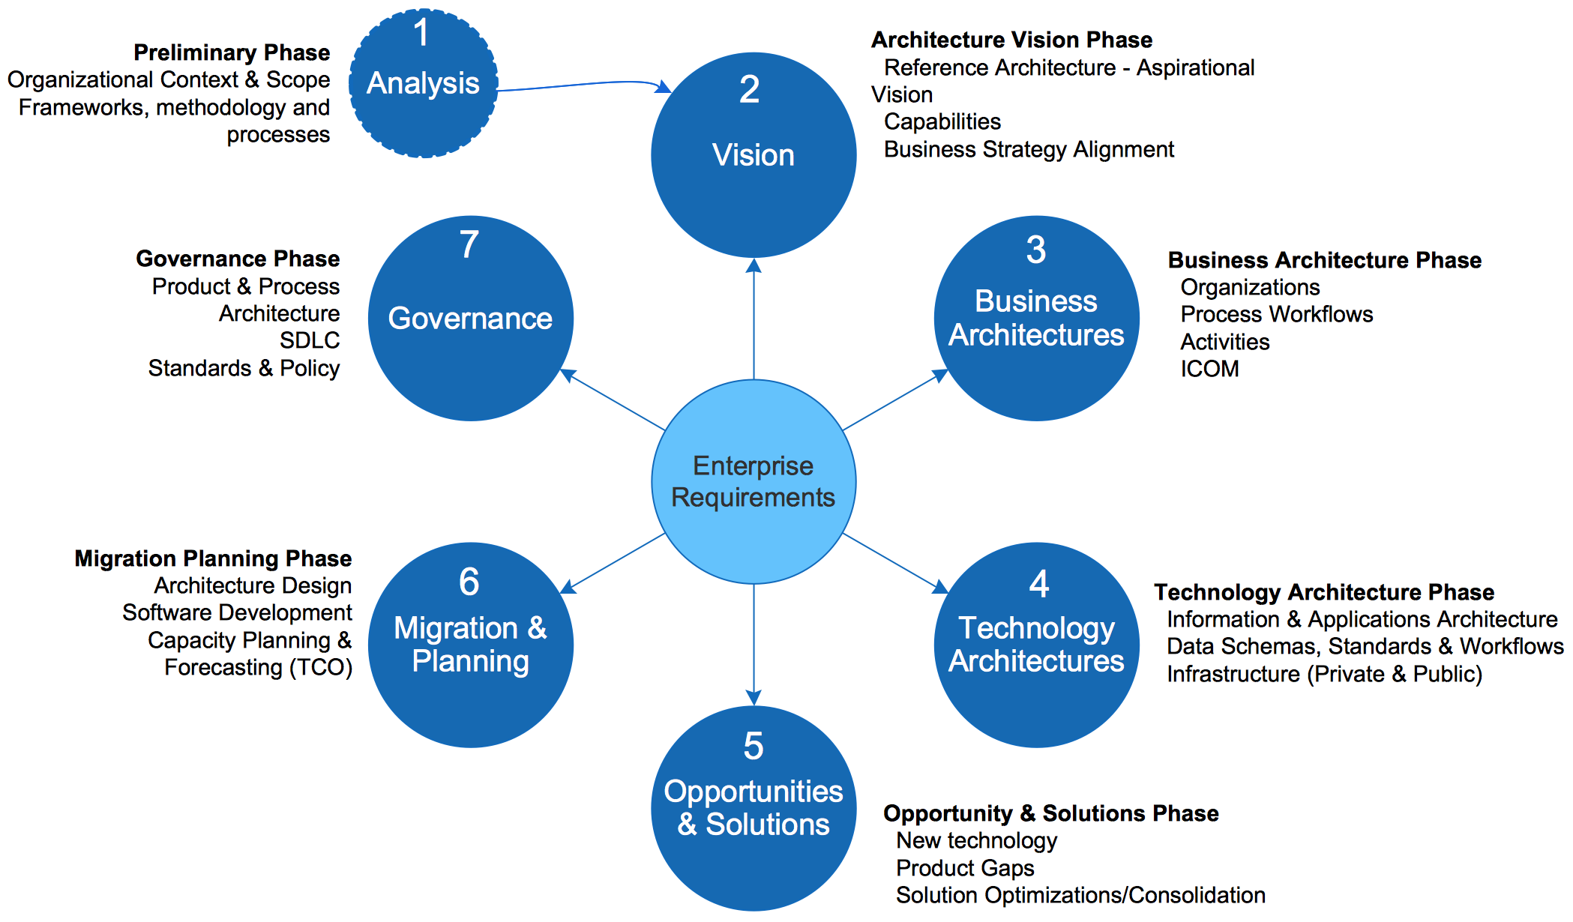
ADM modified for Hedgeserv
This modified ADM is very similar to the traditional TOGAF model. Key goals and activities are highlighted.

Slide 5
Fit-for-Purpose ADM
The modified ADM has 7 phases. The highlighted phases should be our immediate near-term focus:
Analysis
Architecture Vision
Business Architecture
Technology Architecture
Opportunities & Solutions
Migration Planning
Governance

Slide 6
Phase 1: Preliminary Analysis
This phase is the preliminary assessment and kickoff phase
Limit the scope of architecture focus and develop a small sustainable engagement model (scale up)
Establish a common vision
Agree on relevant early artifacts (outputs) of subsequent phases
Execute Business & Technology streams in parallel.

Slide 7
Phase 2: Establish an Architecture Vision
An architecture vision in this case is a set of guiding principles and rules that will guide subsequent architecture activities to ensure the creation of a relevant and valuable reference architecture.
Scalable
Secure
Responsive
Consolidated & Centralized
Transparently Data Driven
Service Oriented
Adaptable to change
These 7 principles should inform both Business and Technology Architectures
Business
Architectures
Technology
Architectures

Slide 8
Phase 3: Establish a Business Architecture
The business architecture will capture
Current state:
Organization structure (roles and responsibilities)
Organization activities (inputs, outputs, constraints, mechanisms)
Organization process mapping (internal and external dependencies)
Organization KPIs (Key Performance Indicators)
Desired state:
Optimal organization structure
Optimal activities
Optimal process mappings (to achieve KPIs)
Constraint
Constraint
Constraint
Input A
Activity
Output X
Input B
Output Y
Input C
Output Z
Activity
Activity
Mechanism 1
Activity
Mechanism 2
Mechanism 3
Business Workflow Mappings

Slide 9
Phase 5: Opportunities & Solutions
Based on our grasp of current state and our desired state, prioritized roadmaps can start to emerge as part of the evaluation of Opportunities and Solutions Phase (5). Research and Development support is critical at this stage.
Current State
Intermediate States
Desired State
Activities
Activities
Activities
Activities
Activities
Activities
Mechanism
Mechanism
UI/UX
UI/UX
UI/UX
UI/UX
UI/UX
Services
Monolithic Services
Services
Micro Services
Micro Services
Micro Services
Services
Containers
Mono Data Repos
Data
Multi Data Repos
Multi Data Repos
Data
Infrastructure
Hybrid
Robust Cloud
Current Supporting Technology Architecture
Future Supporting Technology Architecture

